Slide 1
Walmart Sales Analysis
Using MySQL
From -Faizan ulla Baig
Date : 07/12/2024

Slide 2
1. Introduction
OVERVIEW :
This project analyzes Walmart sales data to uncover insights and trends across branches, customer types, product lines, and sales patterns
OBJECTIVES:
Identify top-performing branches and product lines.
Detect sales anomalies and repeat customers.
Analyze sales patterns by gender, customer type, and day of the week.
Highlight actionable insights for business improvement.

Slide 3
Task 1: Identifying the Top Branch by Sales Growth Rate
Branch | Month | total_sales
A | 1 | 38681.13
A | 2 | 29860.12
A | 3 | 37659.12
B | 1 | 37176.06
B | 2 | 34424.27
B | 3 | 34597.34
C | 1 | 40434.68
C | 2 | 32934.98
C | 3 | 37199.04

Slide 4
Task 2: Finding the Most Profitable Product Line for Each Branch
Branch | Product_line | Profit
A | Home and lifestyle | 1067.5
A | Sports and travel | 922.56
A | Electronic accessories | 872.26
A | Food and beverages | 817.34
A | Fashion accessories | 777.77
A | Health and beauty | 599.93
B | Sports and travel | 951.88
B | Health and beauty | 951.5
B | Home and lifestyle | 835.72
B | Electronic accessories | 812.05
B | Fashion accessories | 781.65
B | Food and beverages | 724.56
C | Food and beverages | 1131.78
C | Fashion accessories | 1026.71
C | Electronic accessories | 903.3
C | Health and beauty | 791.23
C | Sports and travel | 750.63
C | Home and lifestyle | 661.68

Slide 5
Task 3: Analyzing Customer Segmentation Based on Spending
Spending_Tier | Sum of Total_Spent
High | 33827.8605
Low | 26481.147
Medium | 262657.7415

Slide 6
Task 4: Detecting Anomalies in Sales Transactions
Product_line | Average of Total
Electronic accessories | 861.4818333
Fashion accessories | 929.25
Food and beverages | 899.702125
Health and beauty | 891.504
Home and lifestyle | 948.78525
Sports and travel | 912.4756667

Slide 7
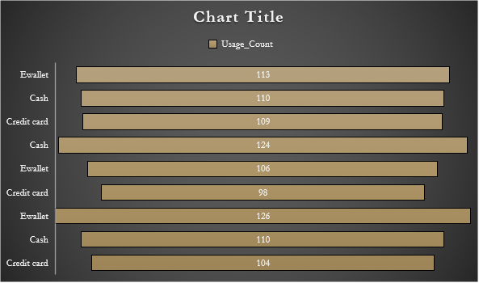
Task 5: Most Popular Payment Method by City
City | Payment | Usage_Count
Mandalay | Ewallet | 113
Mandalay | Cash | 110
Mandalay | Credit card | 109
Naypyitaw | Cash | 124
Naypyitaw | Ewallet | 106
Naypyitaw | Credit card | 98
Yangon | Ewallet | 126
Yangon | Cash | 110
Yangon | Credit card | 104

Slide 8
Task 6: Monthly Sales Distribution by Gender
Month | Gender | Total_Sales
1 | Female | 59138.982
1 | Male | 57152.886
2 | Female | 56335.5555
2 | Male | 40883.8185
3 | Female | 52408.3875
3 | Male | 57047.1195

Slide 9
Task 7: Best Product Line by Customer Type
Sum of Total_Sales | Customer_type
Product_line | Member | Normal
Electronic accessories | 24498.495 | 29839.0365
Fashion accessories | 26323.962 | 27981.933
Food and beverages | 31357.62 | 24787.224
Health and beauty | 25831.0395 | 23362.6995
Home and lifestyle | 27978.027 | 25883.886
Sports and travel | 28234.3005 | 26888.526

Slide 10
Task 8: Identifying Repeat Customer within a specific time frames
-- Task 8 : Identifying Repeat Customers
-- Using subquery
select * from walmart_sales;SELECT DISTINCT ws1.Customer_ID,
STR_TO_DATE(ws1.Date, '%d-%m-%Y') AS Transaction_Date, ws1.Time AS Transaction_Time
FROM walmart_sales ws1JOIN walmart_sales ws2ON ws1.Customer_ID = ws2.Customer_ID AND ws1.Invoice_ID != ws2.Invoice_ID AND ABS(DATEDIFF( STR_TO_DATE(ws1.Date, '%d-%m-%Y'), STR_TO_DATE(ws2.Date, '%d-%m-%Y') )) <= 30;

Slide 11
Task 9: Finding Top 5 Customers by Sales Volume
Customer_ID | Branch | City | Customer_Type | Total_Spent
3 | C | Naypyitaw | Member | 8752.8525
8 | A | Yangon | Normal | 7099.449
13 | A | Yangon | Member | 5881.071
11 | B | Mandalay | Member | 5670.798
7 | B | Mandalay | Member | 5606.9475

Slide 12
Task 10: Analyzing Sales Trends by Day of the Week
Day_of_Week | Total_Sales
Monday | 56758.6635
Thursday | 47825.2425
Sunday | 46254.4425
Friday | 46106.6655
Wednesday | 44292.402
Tuesday | 40947.7425
Saturday | 40781.5905

Slide 13
Conclusion and Recommendations
Summary of Findings
Branch B demonstrated exceptional performance with a 20% sales growth in January 2023, leading all branches.
Electronics and Fashion emerged as the most profitable product lines, consistently outperforming others across all locations.
Monday consistently showed the highest sales volume, while Friday lagged with the lowest sales activity.
Actionable Insights
Focus on underperforming branches by implementing targeted promotional campaigns to boost sales.
Optimize inventory management to prioritize high-demand product lines like Electronics and Fashion.
Launch customer loyalty programs to encourage repeat purchases and strengthen customer retention.

Slide 14
THANK YOU!

